Slide 1
Masculinities
Tyler Mills and Kirstie Riddell

Slide 2
Ice breaker
With the person next to you, draw a masculine person (we will come back to it later!)

Slide 3
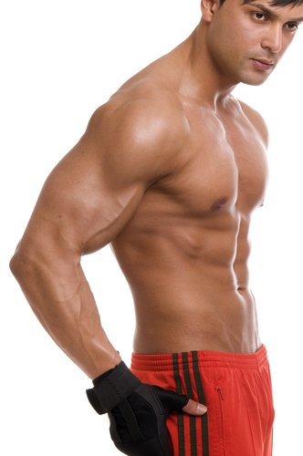
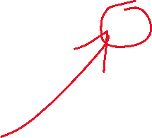
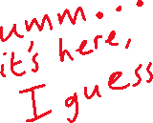
Essentialist definitions
Assumes masculinity is fixed and unchanging among men
Essentialists’ definitions of masculinity point to a particular feature that denotes masculinity
The ‘core’ of masculinity can be defined as activity (vs. feminine passivity), aggression, strength, dominance etc.
This ‘core’ is defined arbitrarily

Slide 4
Positivist social science
Positivism: observing the world and deriving knowledge from it though reason and logic
Positivism asks how men and women behave and live in a given demographic, therefore
Whatever is generally true for men is masculinity
Whatever is generally true for women is femininity
Masculinity is just ‘whatever men are’
Presupposes a few things;
What masculinity and femininity are (to produce a masculinity/femininity scale)
A definition of ‘men’ and ‘women’ to make them observable objects
Women cannot be described as masculine, nor men as feminine

Slide 5
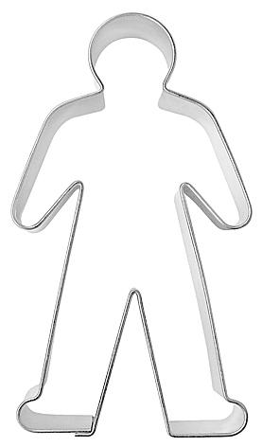
Normative definitions
Masculinity is what men ‘ought to be’
Sets out a masculine archetype or ‘blueprint’ for what is ideally masculine
Criticised for being unrealistic; when almost no man fits the masculine ‘blueprint’, how can it be considered a norm?
This theory incurs paradoxes, can we explain “the toughness needed to resist toughness, or the heroism needed to come out as gay”

Slide 6
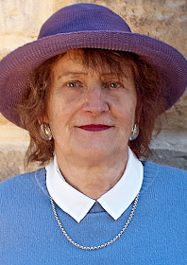
Raewyn Connell
Australian sociologist, trans activist, and professor
Known for the concept of hegemonic masculinity and social theory of gender relations
“To speak of masculinities is to speak about gender relations. Masculinities are not equivalent to men; they concern the position of men in a gender order. ”

Slide 7
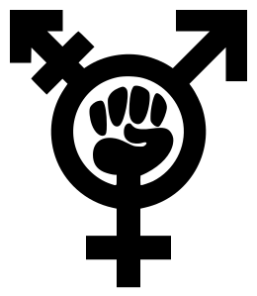
Connell’s theory of masculinities
Masculinity occurs in relation to social, political, and class struggles
Masculinities and power relations are inextricably linked
Conceptions of gender and masculinity are created and perpetuated through every aspect of human life and organization; ideological, institutional, interpersonal, and personal
Intersectional; brings together Marxist and feminist perspectives on power and gender

Slide 8
Gender order
The overall structure of gender relations at a particular time in a particular place
Patterns of ideological and material practices through which power relations between women and men are created and sustained – hierarchical
Note: not always patriarchal
Relationship between body and gender - gender is the outcome of interpretations and cultural definitions of the reproductive and sexual capacities of the body - masculinities and femininities are the effects of these interpretations and definitions
Gender is socially constructed and culturally determined
Notes:
In the UK there is an ideological assumption that men are better suited to STEM careers
This creates material disadvantages for women - women are assumed to be worse in these positions - labor is less valued - paid less than male counterparts

Slide 9



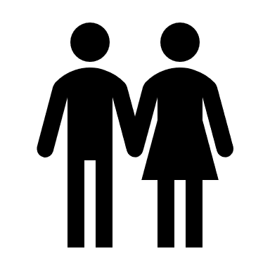

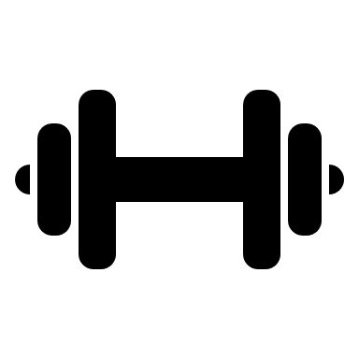
Hegemonic masculinity
Proposed social practices (on a local and global scale) that promote the dominant social position of some men, and the subordinate social position of women and other men
The ‘highest’ point of the hierarchy
Focuses on power dynamics inherent in masculinities – legitimizes men’s power
Explains that despite the co-existence of multiple masculinities, there is often a particular version that exerts the most power
Hard to define but qualities usually include physical strength, suppressing emotions, heterosexuality, yielding power and whiteness

Slide 10
Model of hegemonic masculinity
Patriarchal society
Hegemonic masculinity
Social reproduction of patriarchy
Gendered socialistion
Social/health inequality
Power inequality

Slide 11
Discuss
What are your opinions on the ‘gendered socialization’ aspect of the cycle of hegemonic masculinity?

Slide 12
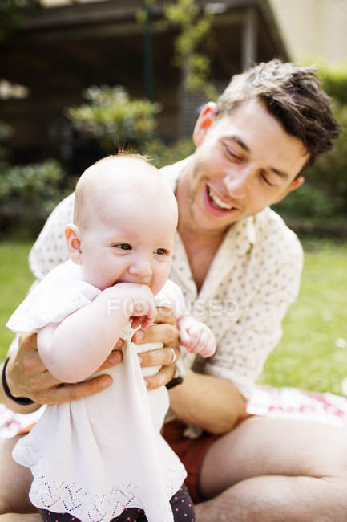
Complicit masculinities
Doesn’t have all the qualities of hegemonic masculinity but doesn’t challenge it either
No one really ‘fits’ hegemonic masculinity so for those who strive toward it, complicit masculinity is more accessible
They may benefit from their status as masculine (e.g. financially, socially) through patriarchal relations
Example: single fathers may not be hegemonically masculine because of their nurturing role

Slide 13
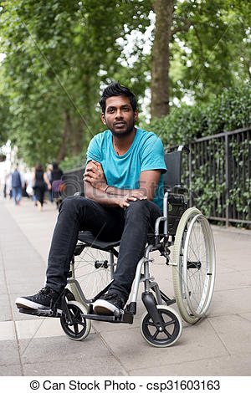
Marginalized masculinities
Cannot access hegemonic masculinity due to certain characteristics
Race, ethnicity, and disability are examples of barriers to hegemonic masculinity
Still may subscribe to hegemonic norms such as physical strength or aggression
‘Protest masculinity’ in which an individual has limited economic, social, or cultural power and constructs a ‘hyper-masculine’ identity

Slide 14
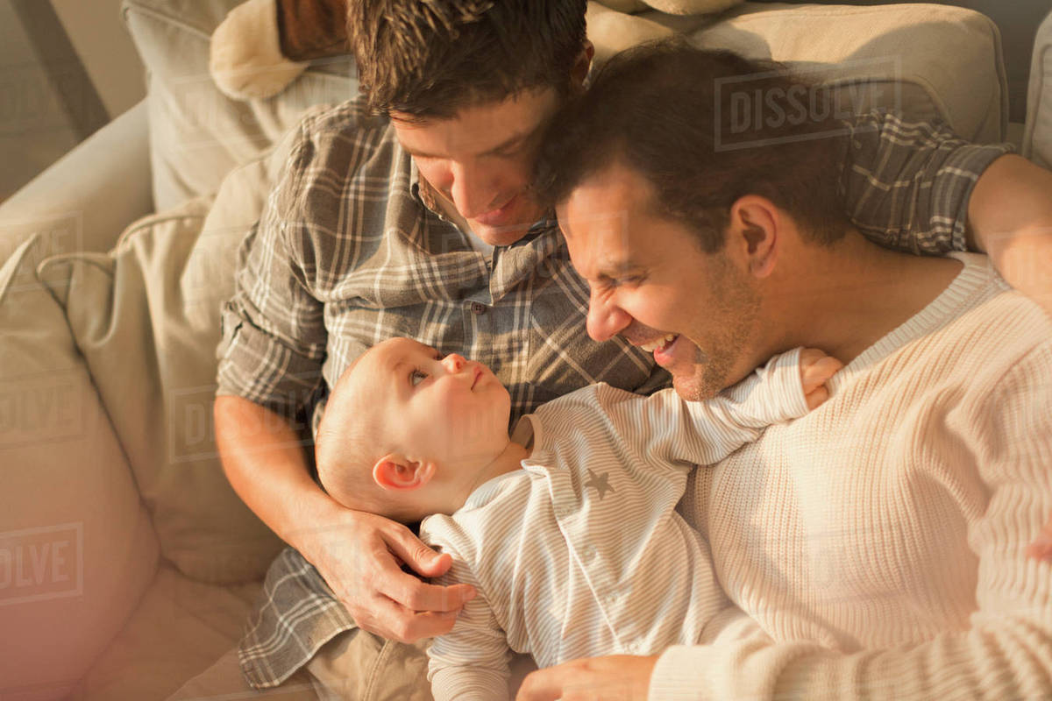
Subordinate masculinities
Exhibit qualities in direct opposition to those of hegemonic masculinity
May be physically weak or be very expressive with emotions
One popular example is gay or effeminate men
Hegemonic masculinity often includes heteronormativity – gay men openly defy this and so are subordinated by men who value hegemonic traits
Notes:
This doesn’t mean that gay men can’t be complicit also, but implied by the ‘gay lifestyle’ is the rejection of certain hegemonic ideals, it doesn’t mean they don’t uphold others.

Slide 15
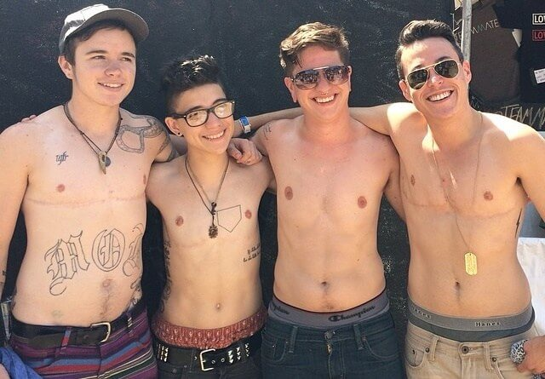
Trans masculinities
Connell states that trans masculinities “are not inherently counter-hegemonic”
Trans men can pursue gender equality or oppose it just like cis-men
Highlights society’s treatment of the body and the way we use our bodies as a medium through which we interact with each other
We can also consider masculinity as protection (enables ‘passing’ which often ensures safety)
Particularly early in transition, masculinity functions as the indicator of a male gender identity

Slide 16
Toxic masculinity
I try not to cry in front of other people.
Connell argues that hegemonic masculinity incorporates ‘toxic’ features such as aggression and violence against women
Others argue that toxic masculinity refers to how conforming to stereotypical ‘masculine’ traits harms men
Men who adhere to cultural norms of masculinity are at higher risk of depression, stress, and substance abuse
Can you think of other negative (or ‘toxic’) attributes/effects of masculinity?
My self-worth is closely linked to success at work.
Hugging my male friends makes me uncomfortable

Slide 17
Discussion and comments
- Do you think trans masculinities are counter-hegemonic? - How is your relationship to masculinity affected by your relationship to gender identity? - Does Connell’s theory make sense to you in your life? - What effect do you think the hierarchy of masculinities have on you/your community/the world?

Slide 18
Discuss
Back to the drawings you did earlier!
Looking at your drawing, would you draw your masculine person differently now?
Would you say you drew a hegemonic, complicit, marginalized, subordinated person?

